Slide 1
SIMPLE GUI CALCULATOR USING Tkinter
Presented By:-Tanuja Sharma
Affiliated BY: -DIGICROME ACADEMY

Slide 2
INTRODUCTION
To make a calculator program in Python, and now you want to learn how to build a GUI (graphic user interface) for such a program, so it’s more presentable and easily.
Python is a popular programming language. It was created by guido van rossum , and released in 1991.
It is used for:-
Web development(server-side),
Software Development
Mathematics
System Scripting
The biggest strength of the python is huge collection of standard libraries which can be use for the following gui applications(like kivy,tkinter,PYQT).
Machine learning
Web framework ,test framework
Image processing, text processing
Multimedia and many more.

Slide 3
ABOUT THE PROJECT
For those who don’t know, a calculator is basically a program on a computer that simulates the behavior of any hand-held calculator useful for performing mathematical calculations . It is a very basic device use in our everyday lives . Now all the smartphones also have a calculator application in them.
we will be working with tkinter, which is the standard GUI library for Python. If you are interested in learning more about the library and its functionality,
While creating any GUI there are two steps:-
First step is to create a user interface.
Second to add functionalities to the gui.

Slide 4
Problem statement:-
from tkinter import * #Create a calculator class
class Calculator:
#Step 2 and 3: create the __init__ method
def __init__(self, master):
''' Method that initializes the object's attributes ''‘
#Step 4: Assign reference to the main window of the application
self.master = master
#Step 4: Add a name to our application
master.title("Python Calculator")
#Step 5: Execution
if __name__ == '__main__':
#Step 6: Create the main window of an application
root = Tk()
#Step 6: Tell our calculator class to use this window
my_gui = Calculator(root)
#Step 6: Executable loop on the application, waits for user input
root.mainloop()

Slide 5
Solution:-
Specify what should happen when we run the code:
Define a local variable root and assign Tk() to it. Tk() is a tkinter class which creates the main application window.
Define another local variable my_gui and assign Calculator class to is while passing root as an argument into it. Essentially this step creates a GUI by telling a class to use root (which is Tk()) as it’s main window.
Add root.mainloop() where mainloop() is a method of Tk() basically telling the app to wait for events (clicks) and update the UI accordingly.

Slide 6
METHODOLOGY
TOOLS:-Python
Python libraries:-Tkinter,etc.
Tkinter:-Tkinter is a standard gui library for Python. python when combined with Tkinter provides a fastest and easiest way to create gui application.Tkinter provide a powerful object-oriented interface to the Tk gui toolkit.
Learning Outcome:
1. Core Python
2. tkinter Library
3 Visual Studio Code[IDE]
4. GitHub
5. Application development using Python programming language

Slide 7
Key features:- The GUI we will be building will look like this: The following features should be considered as “must haves” for this app: It must have an equation line (screen) to display the mathematical equation and the result. It must have buttons which must represent numerical values or mathematical operations, and be clickable.

Slide 8
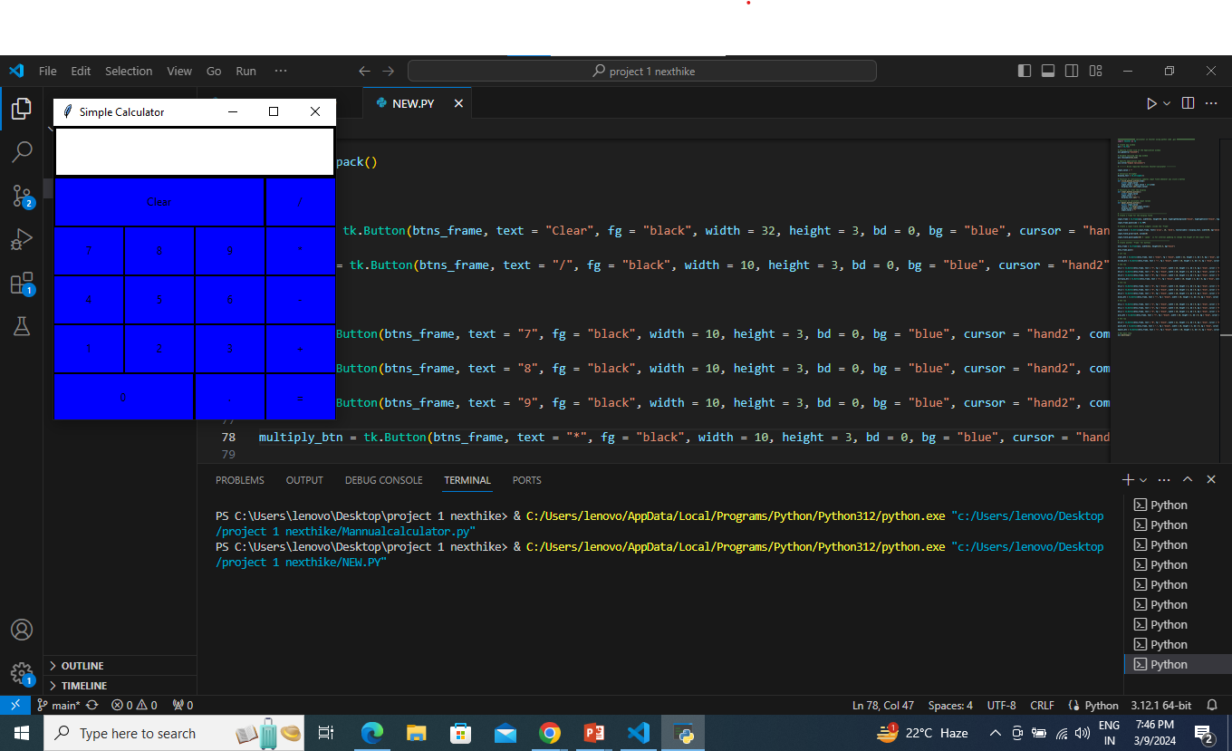
OUTPUT:-

Slide 9
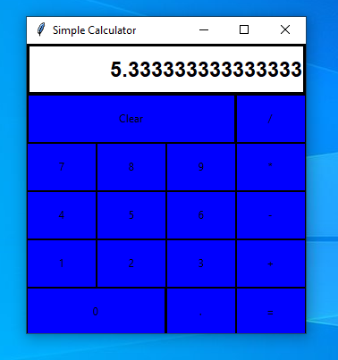
RESULT AND ACHEIVEMENTS:-

Slide 10
Use case diagram
calculator
Calculate expression
user
Store result
Display previous result
Display result

Slide 11
CHALLANGES FACED:-
There are many challenges facing in the project:-
Challenges related with syntax error.
Challanges related with codes .
Challenges relates with functionality and buttons.
Challenges relates with run codes in vs code , work on gui environment and in Tkinter.

Slide 12
CONCLUSION:-
create a custom basic GUI calculator in Python using tkinter library.
Here is how our calculator will look:- which is made by using the input field, buttons and for the calculation purpose we will use logic in our code defined in functions, like if you want to add two numbers then behind this there must be a logic for addition purpose, similarly for subtraction, multiplication, we have created functions whose task is to perform these operations.
Apart from the Tkinter widgets, we have defined the following functions in our code:
btn_click() Function: This function handles the button click on various numeric buttons to add them to the operation.
bt_clear() Function: This function is used to handle the clear operation to clean the previous input in the Calculator application.
bt_equal() Function: This function is used to handle the equal button to execute the operation and show the result.

Slide 13
THANK YOU

